Slide 1
AGRI-HR Kyrgyzstan
Kyrgyz-British Business Council Meeting
25th April 2024
Aigul Eshenkulova

Slide 2
AGRI-HR
AGRI-HR is a seasonal agricultural recruitment business.
Founded in 2019 by Jan-Willem Naerebout .
A Kyrgyz branch office was established in March 2022 and managed by Aigul Eshenkulova.
The branch office operated under the agreement of the Centre for Employment of Citizens Abroad under the Ministry of Labour, Social Security and Migration of the Kyrgyz Republic.
The first Kyrgyz citizens arrived in the UK in May 2022

Slide 3

Recruiting for other operators:

Slide 4
AGRI-HR
AGRI-HR became a UK Government appointed Seasonal Worker Scheme Operator in January 2023.
AGRI-HR Kyrgyzstan LLP was established in 2023 with a Kyrgyz recruitment licence & British GLAA licence.
The Business continues to be managed by Aigul Eshenkulova.
Since 2022 AGRI-HR have recruited over 4,500 Kyrgyz citizens for the UK agricultural sector.
AGRI-HR is the first & also the largest recruiter in Kyrgyzstan.

Slide 5
AGRI-HR Key facts & subscriptions
GLAA Licence No: AGRI0021 (UK) & AGRI0030 (KG)
Kyrgyz Recruitment licence No: 001060
Operator Licence No: QK4N14WX5
ALP Membership: 8872 – ALP Council Member
Responsible Recruitment Toolkit
Ethical Trade Initiative - SEDEX Member
NFU Professional Member
Member of Hereford & Worcester Chambers of Commerce.

Slide 6





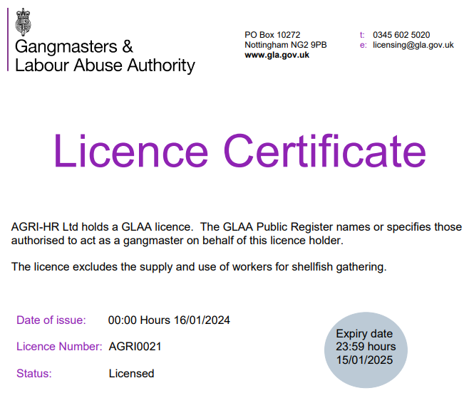

AGRI-HR Key facts & subscriptions

Slide 7
Any Questions?
Thank You!

